Slide 1

Blockchain Technology
A Revolution in Trust

Slide 2

Blockchain Technology
CONTENTS
Introduction
Applications of Blockchain
How Blockchain Works
Future Trends
Benefits of Blockchain
Conclusion

Slide 3
Introduction
Blockchain is a transformative technology that revolutionizes how we store and exchange digital information. It is a decentralized, distributed ledger system that ensures transparency, security, and immutability of data through cryptographic techniques. Unlike traditional centralized databases, blockchain operates on a network of computers, or nodes, where each transaction is recorded in a secure block, linked together in a chain. This technology gained prominence with the advent of cryptocurrencies like Bitcoin but has since expanded to various industries, promising to redefine trust and revolutionize record-keeping, supply chains, financial transactions, and more.

Slide 4
Centalized
Decentralized
Centralized systems concentrate control and decision-making authority within a single entity or a few central authorities, leading to efficient management and streamlined processes.
The centralized approach can result in cost savings and uniformity in decision-making, enhancing coordination within the organization.
However, centralization also introduces a single point of failure, making the entire system vulnerable to breaches or failures in the central authority, which can lead to data loss or disruptions
Decentralized systems distribute control and decision-making among multiple nodes, ensuring that no single entity holds complete authority. Consensus mechanisms are used to achieve agreement among participants.
Decentralized systems are highly resilient and resistant to failures or attacks because there is no single point of failure. Even if some nodes are compromised, the network can continue to operate.
Trustless transactions are a key feature of decentralized systems, where participants can interact and transact without relying on a central authority. Trust is established through cryptographic and consensus mechanisms, enhancing security and transparency.

Slide 5



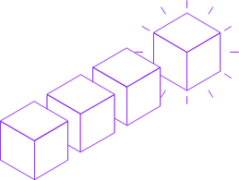
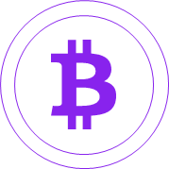
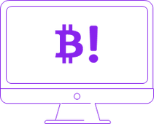
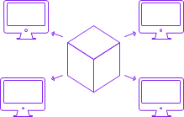
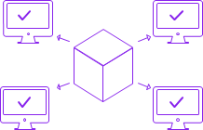
How a Blockchain works
A Transaction is requested
The block representing the transaction is created
The block is sent to every node in the network
Nodes validate the transaction
The transaction is Completed
The block is added to existing blockchain
Nodes receive a reward for proof of work

Slide 6
The Benefits
of blockchain

Slide 7
Decentralization and Elimination of Intermediaries
Security and Immutability
Transparency and Trust
Blockchain removes central intermediaries like banks or notaries, reducing costs and time in transactions and processes. This decentralization fosters peer-to-peer interactions, democratizes service access, promotes financial inclusion, and diminishes the power of centralized authorities.
Blockchain offers robust security through cryptographic hashing and decentralization, making it extremely difficult to alter or delete records once they're added. This immutability establishes trust, making blockchain ideal for critical applications like financial transactions, supply chain management, and legal contracts.
Blockchain's public ledger ensures transparency, enabling anyone in the network to view and verify data independently. This transparency fosters trust among participants and is especially valuable in trust-dependent industries like healthcare and food supply chains.

Slide 8
Applications of Blockchain Technology
Cryptocurrencies: Blockchain's primary application, cryptocurrencies like Bitcoin and Ethereum, enable secure, peer-to-peer digital transactions without the need for intermediaries. These decentralized digital currencies have gained popularity as alternatives to traditional financial systems.
Supply Chain Management: Blockchain enhances supply chain transparency and traceability. It allows participants to record and verify every step of a product's journey, reducing fraud, ensuring product authenticity, and optimizing logistics, making it invaluable for industries like food, pharmaceuticals, and luxury goods.
Smart Contracts: Smart contracts are self-executing agreements coded on blockchain platforms. They automatically enforce contract terms when predefined conditions are met, reducing the need for intermediaries in legal and financial transactions. These contracts are used in diverse applications, from insurance to real estate

Slide 9
Trends and the Future Blockchain Technology
Scalability Solutions: One key trend is the ongoing development of scalability solutions like sharding and layer 2 solutions (e.g., Lightning Network and Ethereum 2.0) to address blockchain's capacity constraints, enabling it to handle a higher volume of transactions and data.
Cross-Chain Interoperability: The future of blockchain technology lies in enabling different blockchain networks to communicate and share data seamlessly. Interoperability protocols and cross-chain bridges will facilitate the exchange of assets and information across multiple blockchains.
DeFi and Decentralized Finance: The expansion of Decentralized Finance (DeFi) applications is a significant trend. DeFi platforms offer services such as lending, borrowing, and trading without traditional intermediaries, democratizing access to financial services.
Non-Fungible Tokens (NFTs): NFTs have gained immense popularity as digital assets representing ownership of unique items like art, collectibles, and virtual real estate. This trend is expected to continue, with NFTs extending into gaming, entertainment, and digital identity verification.

Slide 10

The blockchain technology has emerged as a groundbreaking innovation that promises to reshape industries and redefine trust in the digital age. With its foundational principles of security, transparency, and decentralization, blockchain has proven itself indispensable in applications ranging from cryptocurrencies to supply chain management and smart contracts. As it continues to evolve, blockchain's future trends point toward enhanced scalability, cross-chain interoperability, the democratization of finance through DeFi, and the ever-expanding realm of NFTs. With these advancements, blockchain stands poised to revolutionize how we transact, share, and trust data, unlocking new possibilities for a decentralized and secure digital world.
Conclusion

Slide 11

Q & A

Slide 12

Thank You!

